Slide 1
EDA Case Study 2
Employment Data Analysis
by
Ikenna Nwaogu

Slide 2
Goals
DDSAnalytics is an analytics company that specializes in talent management solutions for Fortune 100 companies.
Identify the top three factors that contribute to turnover backed up by evidence provided by analysis
We are to build a model to predict the Attrition (Yes or No) with a data set with 72 different features. We are to analyze the data and get the best model that will attain at least 60% sensitivity and specificity (60 each = 120 total) for the training and the validation set.
We are to build a model to predict the Monthly Income with the same data set with 72 different features. Our goal is to get a low root mean square error (RMSE<3000) for our prediction from the model we build.

Slide 3
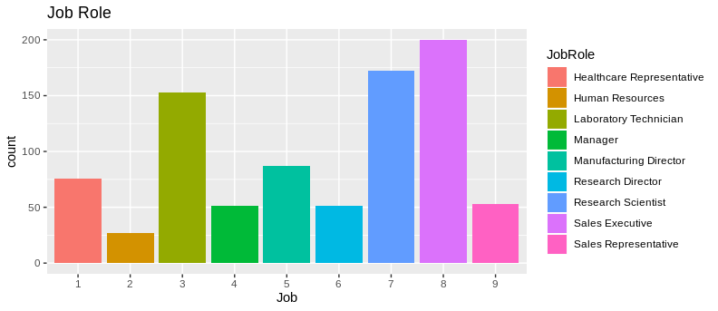
Job Role Distribution Count

Slide 4
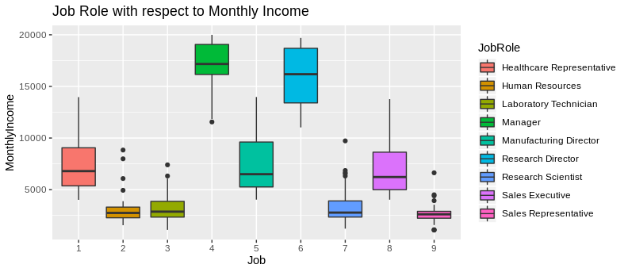
Data relationship with Job Role

Slide 5
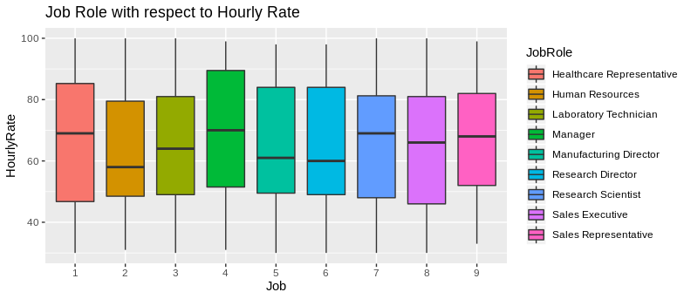
Data relationship with Job Role

Slide 6
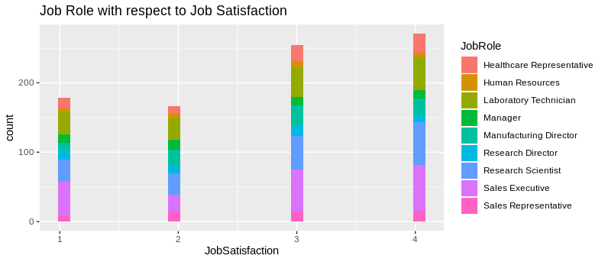
Data relationship with Job Role

Slide 7
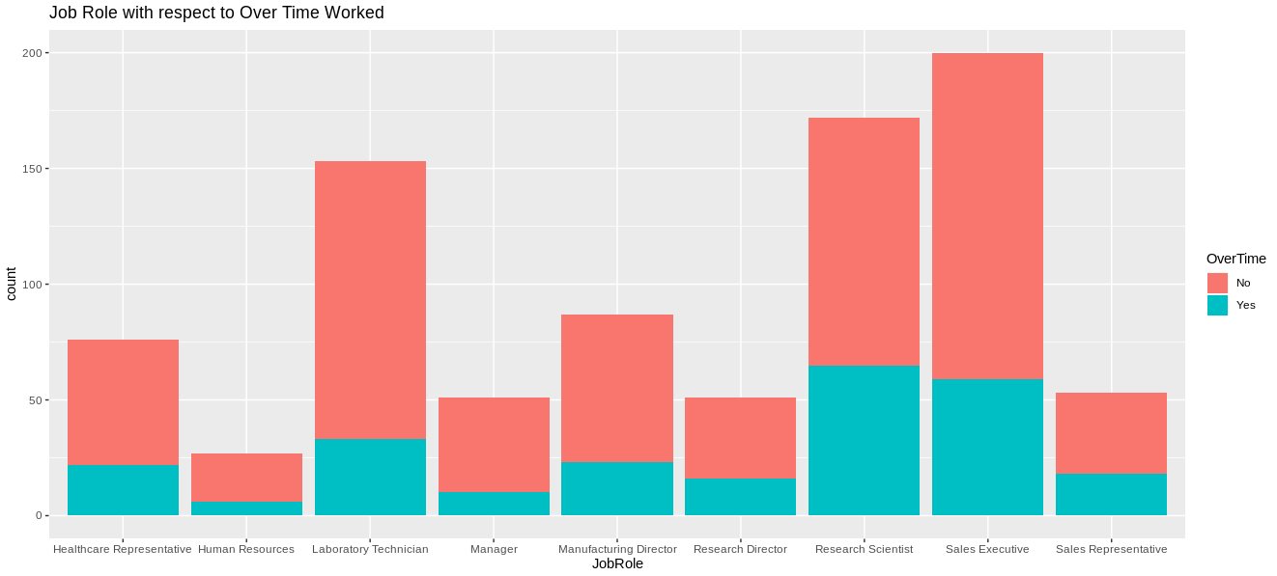
Data relationship with Job Role

Slide 8
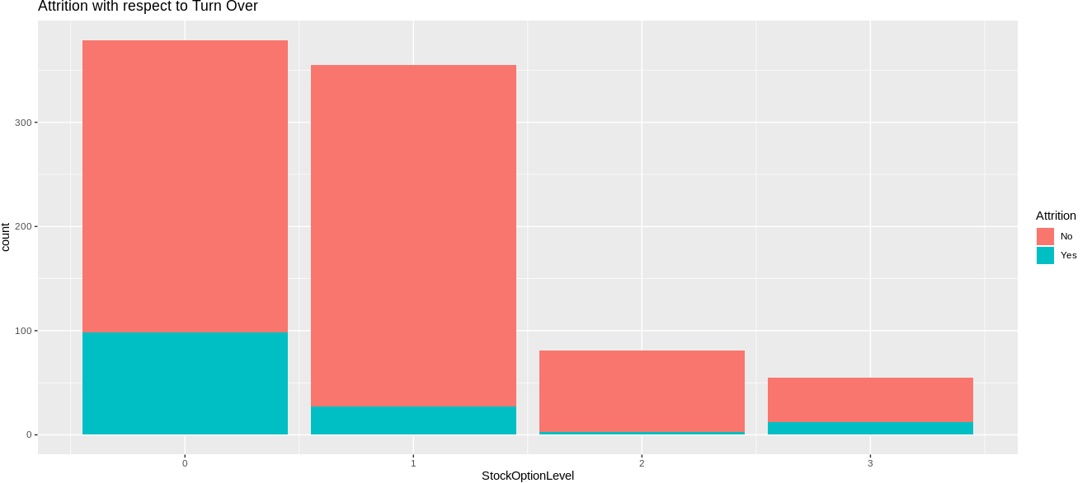
Attrition Relationships

Slide 9
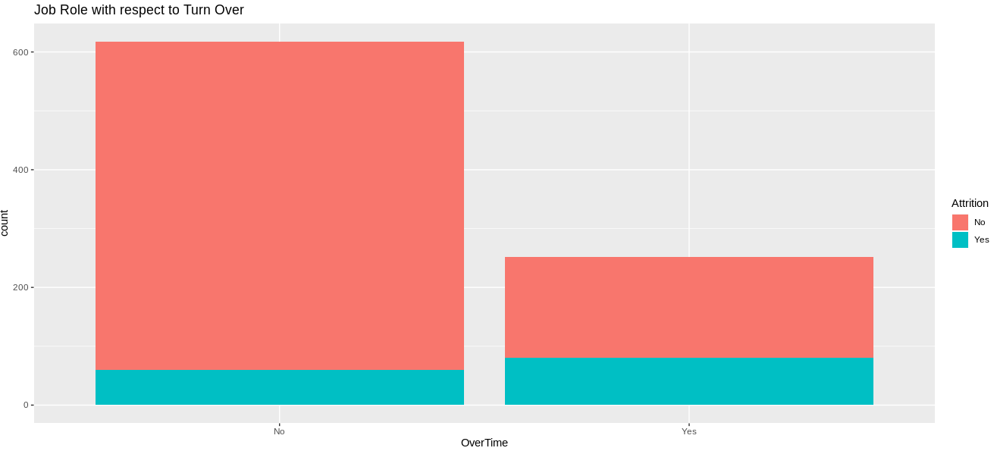
Attrition Relationships

Slide 10
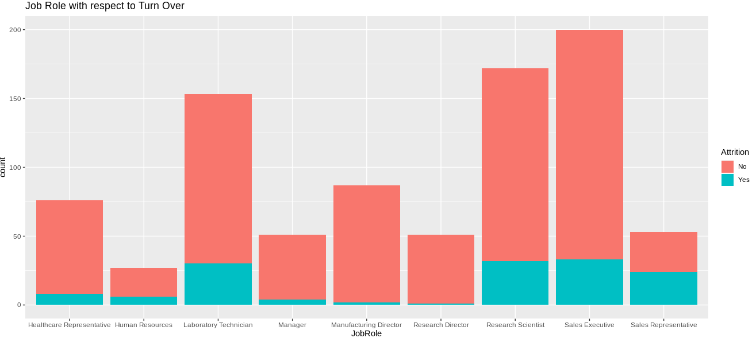
Attrition Relationships

Slide 11
Model Selection (Attrition)
Naive Bayes using Feature/Variable selection

Slide 12
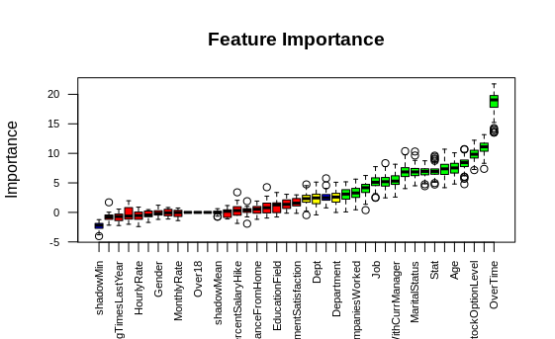

Feature Selection Using Boruta.

Slide 13
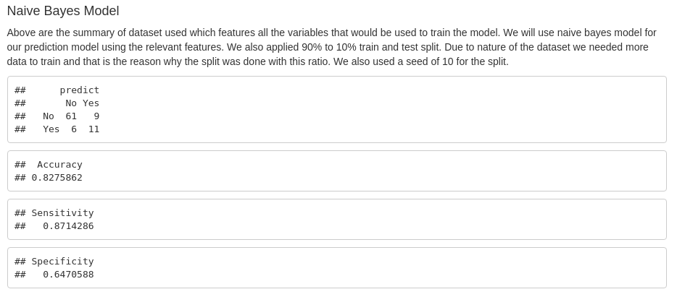
Classification prediction Model

Slide 14
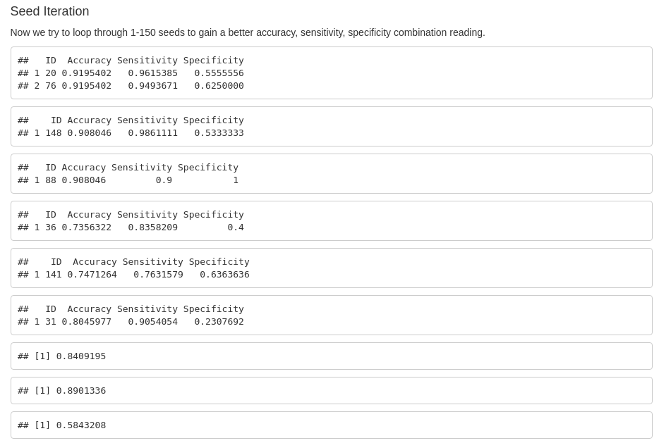
Naive Bayes Model Contd..

Slide 15
Model Selection (Monthly Income)
Regression using Feature/Variable selection

Slide 16
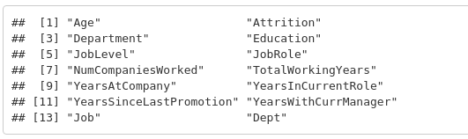
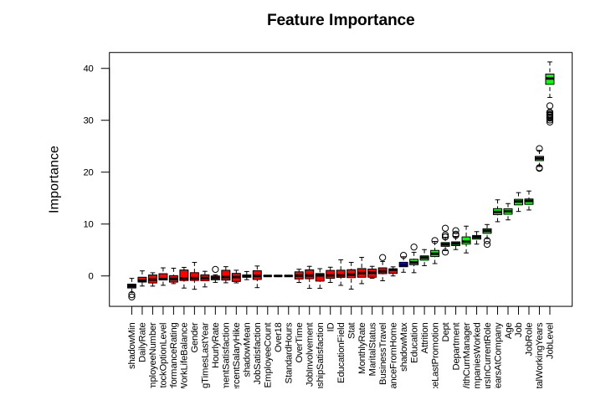
Feature Selection Using Boruta.

Slide 17
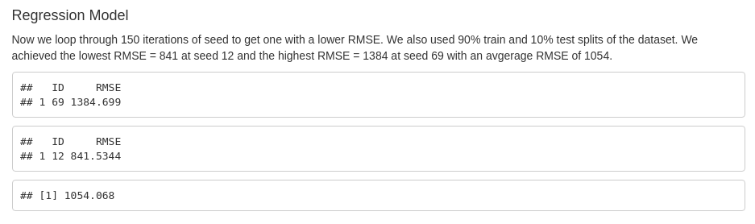
Continuous Variable prediction Model

Slide 18
Takeaways
We analyzed at data set for employment attrition and how it relates to other variables in the data set; we have also analyzed how some of these variables relate to the monthly income.
We need more data, for our classification because there were much more No than Yes.
There were about 15-20 important variables for classification and 12 for regression model. There were less for regression.
We achieved the goals set for our classification and regression models.

Slide 19
END

